Slide 1

W2W
Scheduling
Click to Begin

Slide 2
Error!
Please follow the on-screen
instructions to continue.
Go Back

Slide 3

Complete
Please navigate to the next module
in the course to continue.
Restart Course

Slide 4
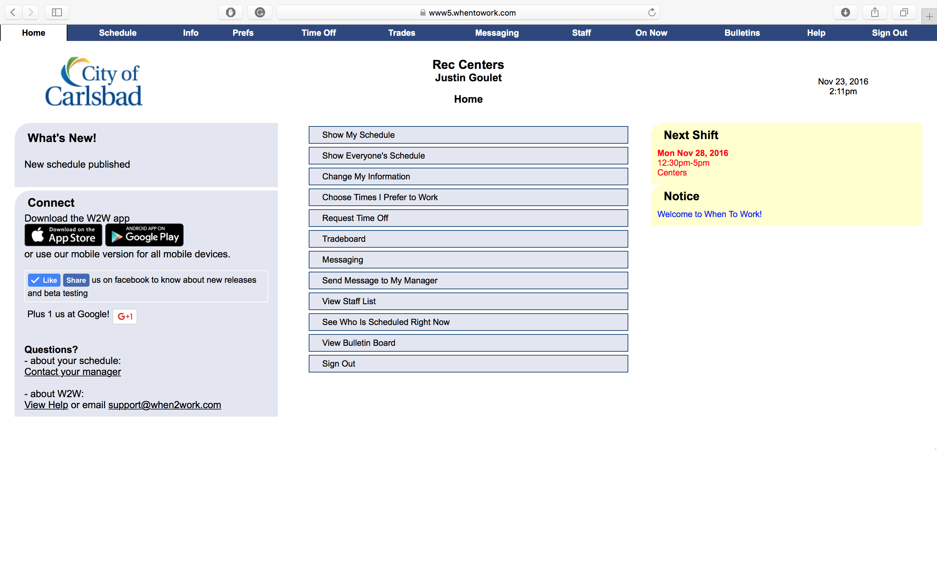
Get To Know When to Work
Tip:
In this tutorial, We are going to just get you familiar with the different options available within this software package.
Your team may be using all of these features in daily activities, so it is a a good idea to learn them quickly.
Click Show My Schedule

Slide 5
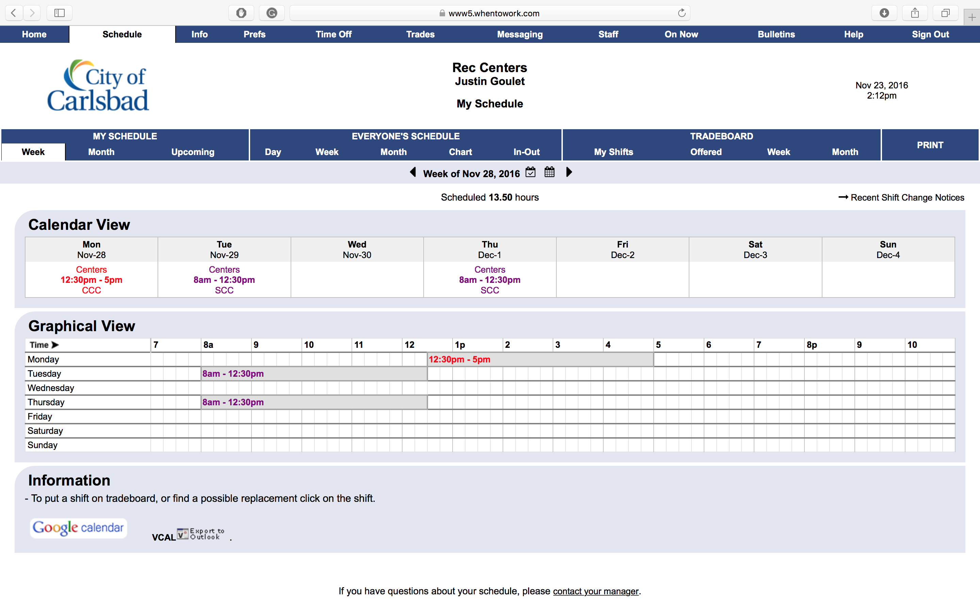
Weekly Schedules
Tip:
This page is purely for you to get the information you need in regards to your upcoming shifts.
You can select a week by pressing the calendar next to the current date, or click the arrows to navigate directly to the next week.
Click any option in the highlighted area to view another page.

Slide 6
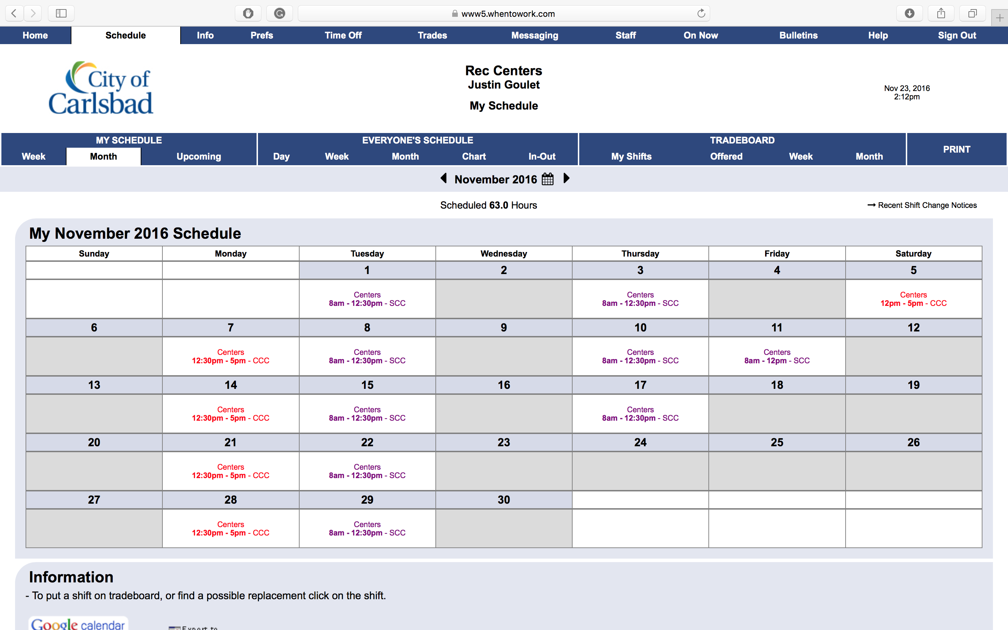
Monthly Schedules
Tip:
Similar to the Week scheduling page in My Schedule, this page shows a monthly view of all of your scheduled shifts.
From this page, you can see your total hours scheduled in the current month as well as see recent shift change notes (if applicable)
Click any option in the highlighted area to view another page.

Slide 7
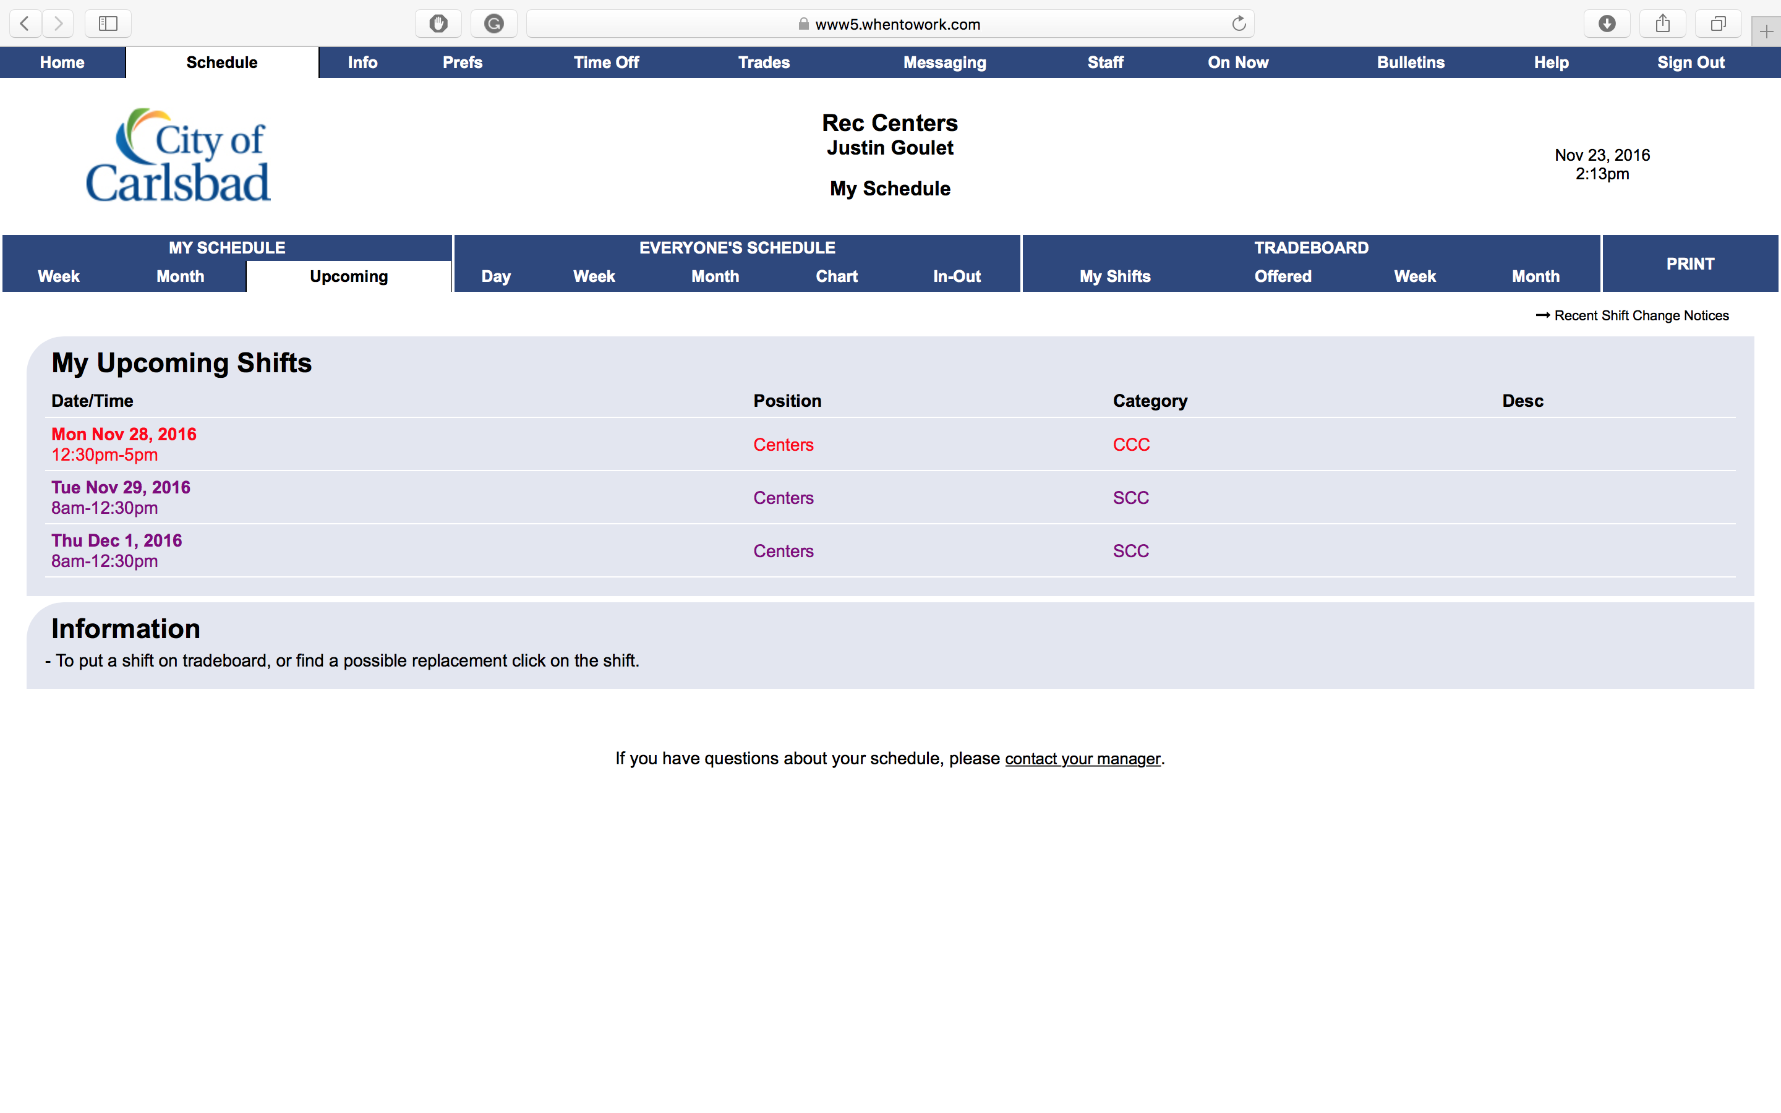
Upcoming Shifts
Tip:
If you are looking for an easy way to check your next shifts, that may have just become available, this is the best place to go.
This page will show you all published schedules, for just your shifts.
Click any option in the highlighted area to view another page.

Slide 8
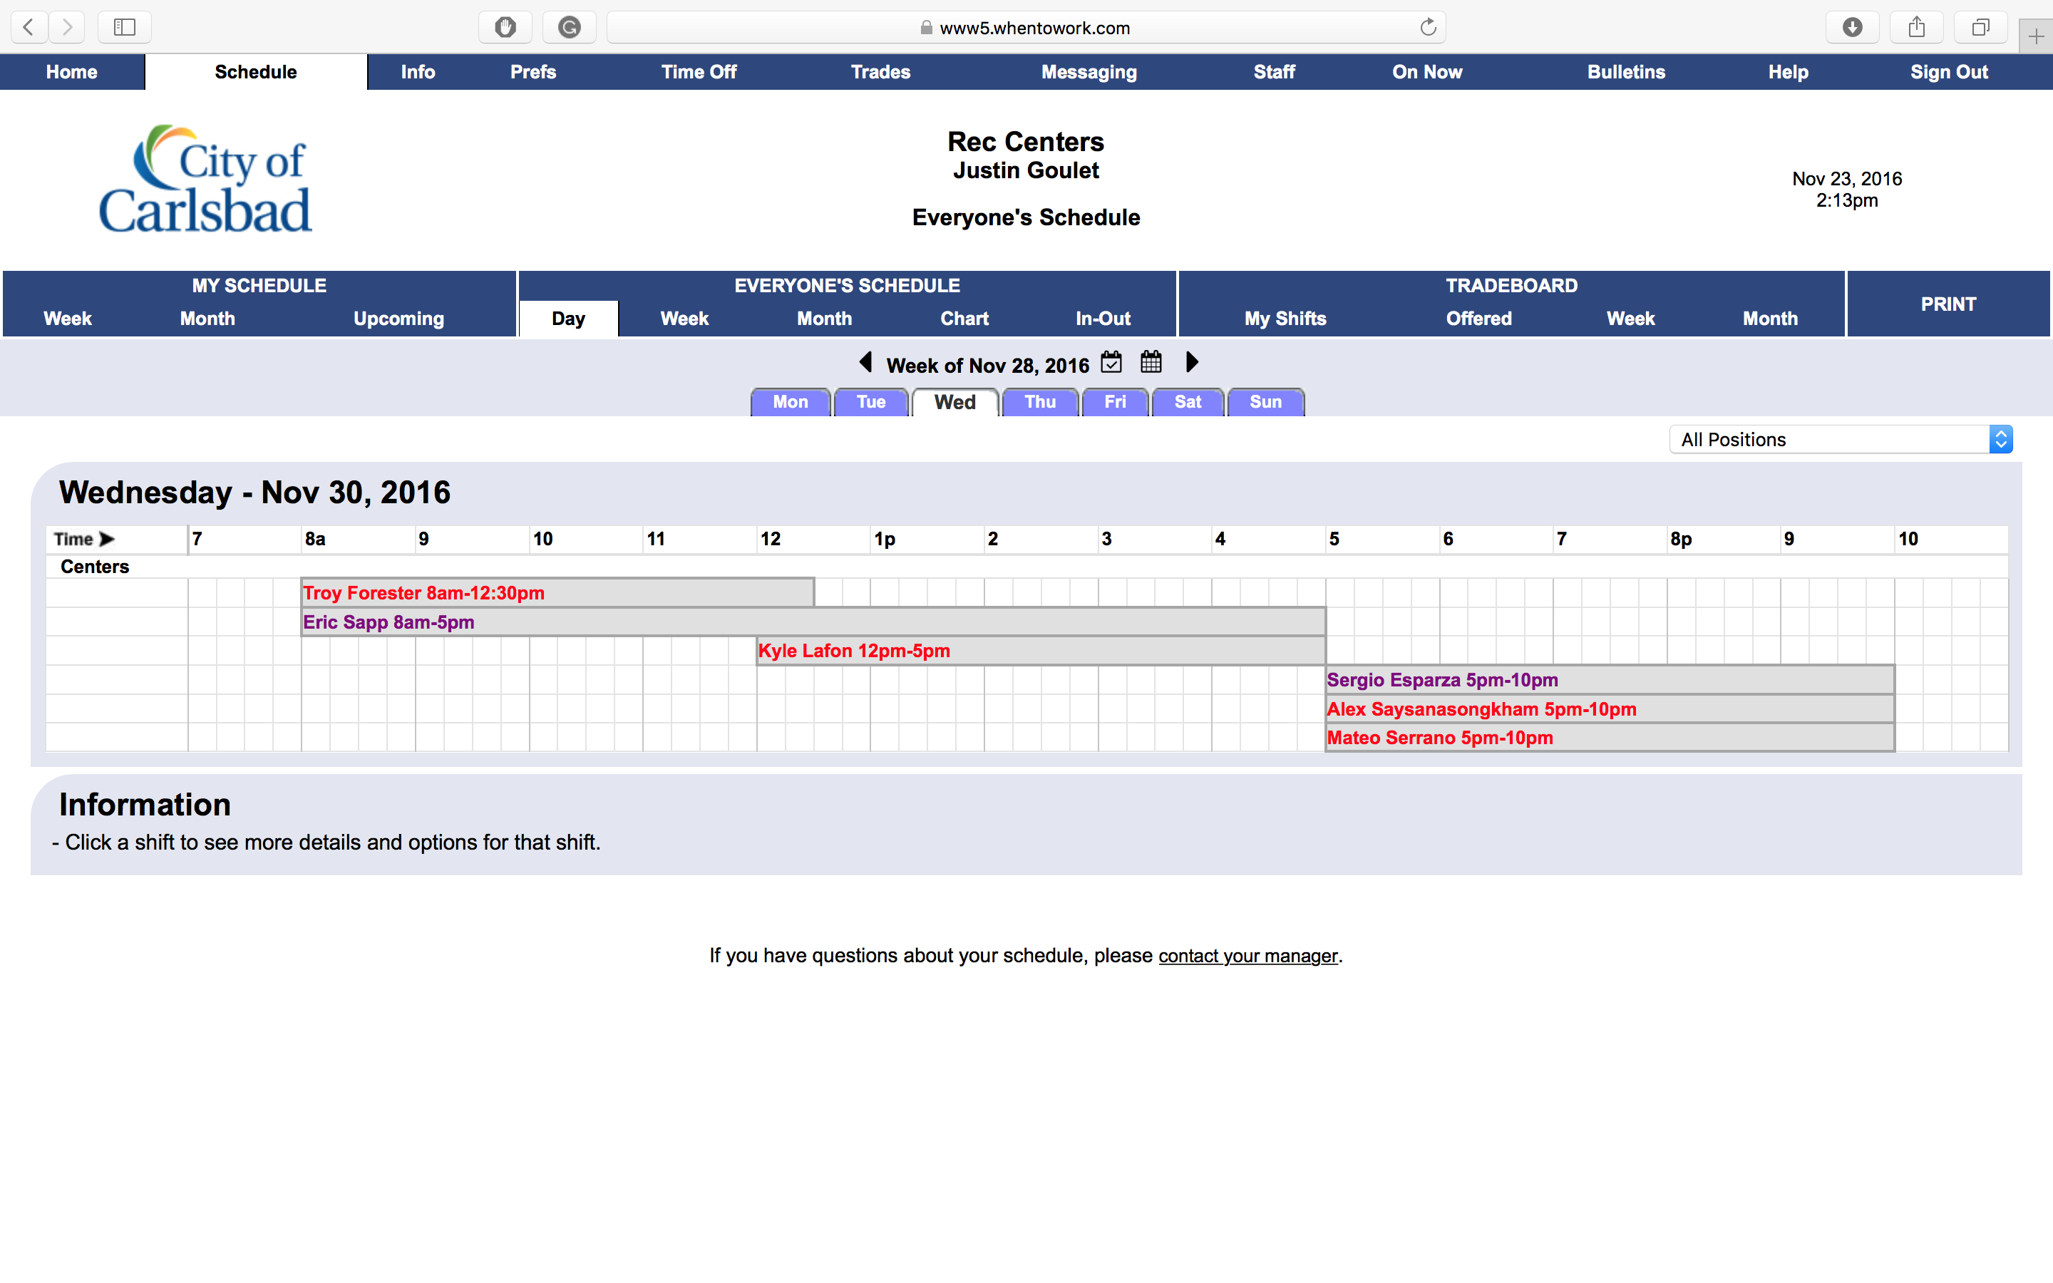
Everyone’s Schedule - Day
Tip:
This schedule provides a quick outline of all employee’s (under the same manager) shifts throughout the day.
Using this schedule, you can determine who was before you, who was after you, and who is on now.
Click any option in the highlighted area to view another page.

Slide 9
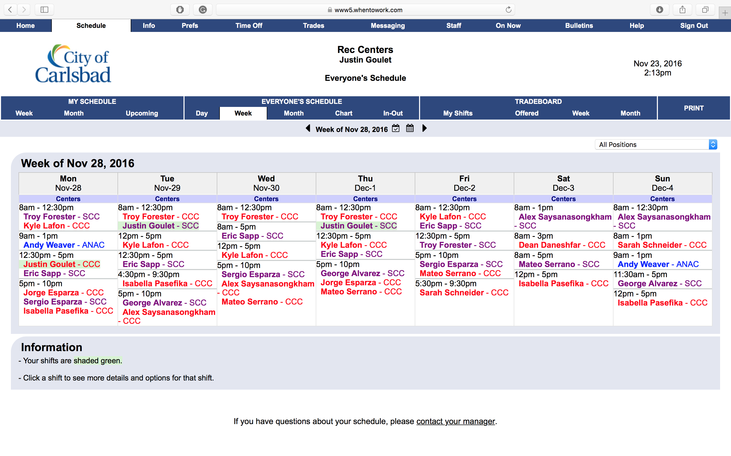
Everyone’s Schedule - Week
Tip:
This schedule has a lot of information compared to the Day schedule for employees.
This schedule is a great tool to see who is working that shift a few days in advance to think about posting a trade to the trade-board
Click any option in the highlighted area to view another page.

Slide 10
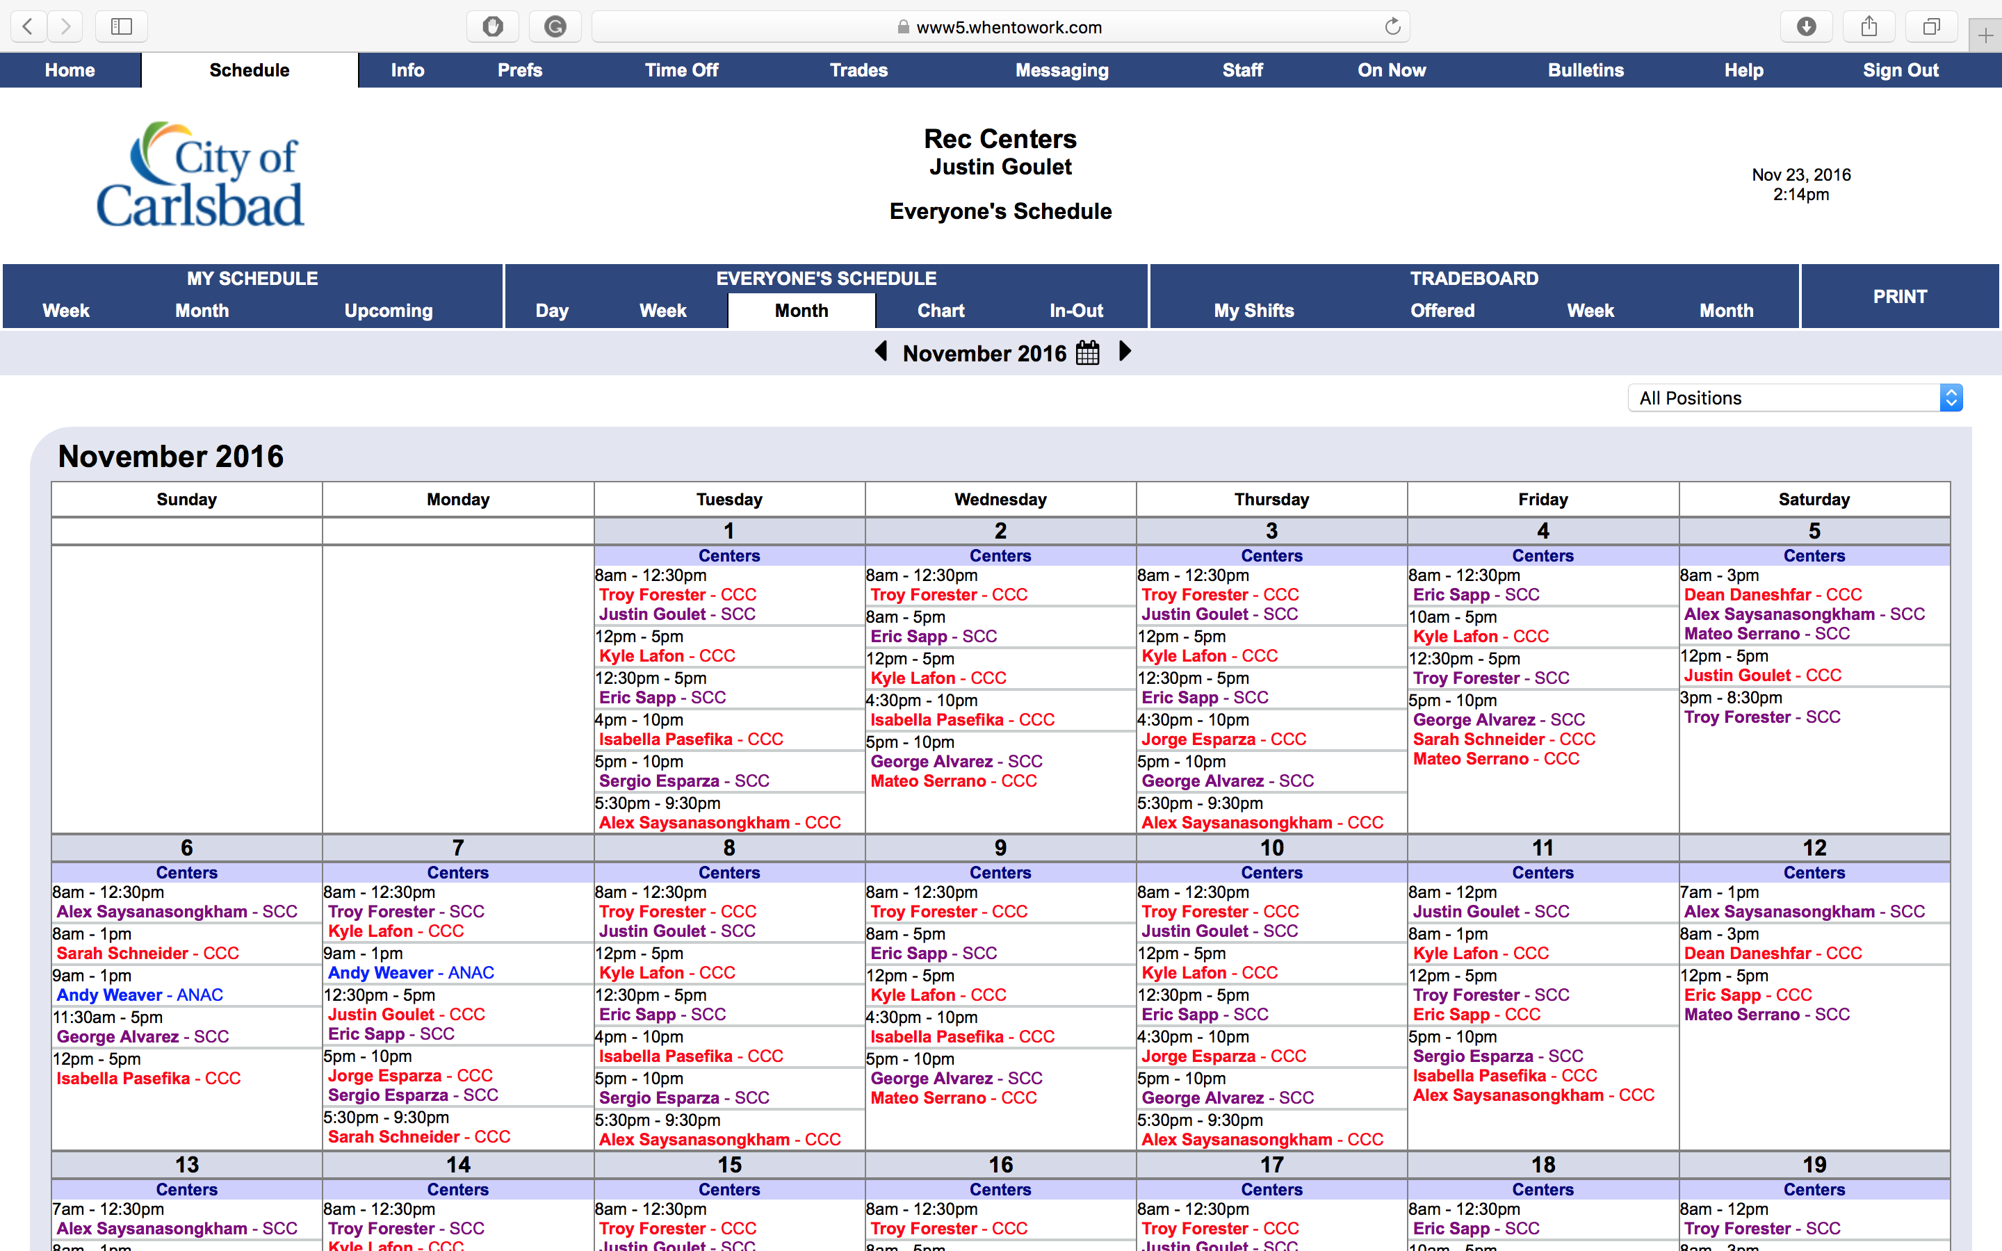
Everyone’s Schedule - Month
Tip:
Just like the week schedule, this view has more information than the week view.
Here, you can see who is working any day of the current month-or you can change the month by using the arrow buttons next to the month name)
Click any option in the highlighted area to view another page.

Slide 11
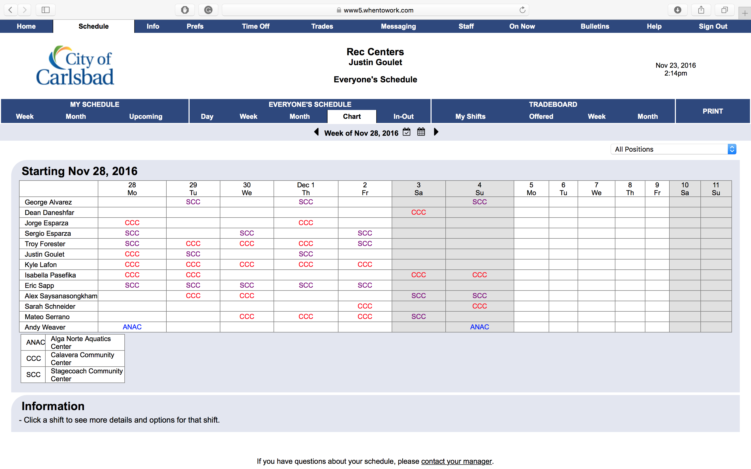
Everyone’s Schedule - Chart
Tip:
The Chart View calendar shows just the center that is staff is scheduled to work for.
This may be different based on your location and the tags your manager chooses to use.
Click any option in the highlighted area to view another page.

Slide 12
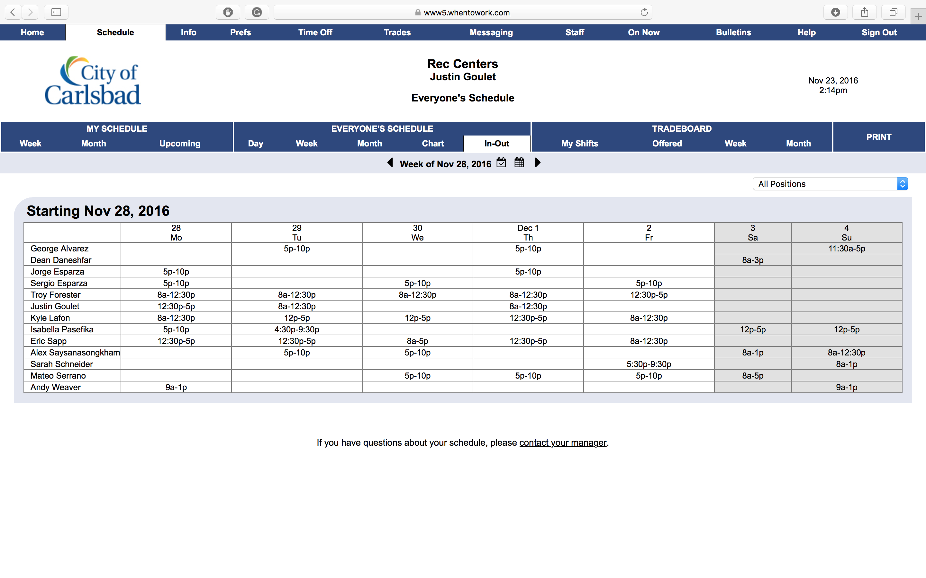
Everyone’s Schedule – In/Out
Tip:
The In-Out view provides a simple look at just the shift times of each employee.
Click any option in the highlighted area to view another page.
Click any option in the highlighted area to view another page.

Slide 13
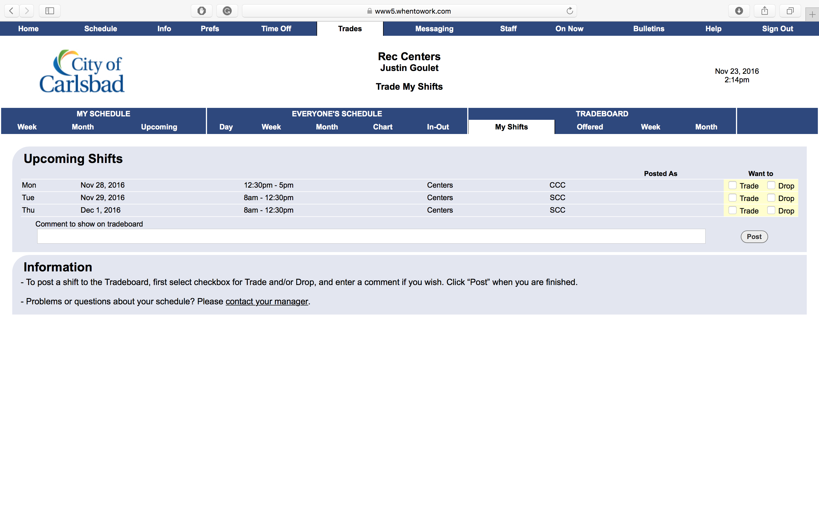
Tradeboard – My Shifts
The Tradeboard allows you to trade shifts with fellow employees. My viewing your upcoming shifts, you can select if you want someone to trade shifts with you or completely take it over.
To Post a new Trade, select the appropriate checkbox next to the shift (on the right), add a comment, and select Post.
Please note that all trades must be approved by a manager. Your manager will be able to view this once a coworker accepts a trade.
Tip:
Click any option in the highlighted area to view another page.

Slide 14
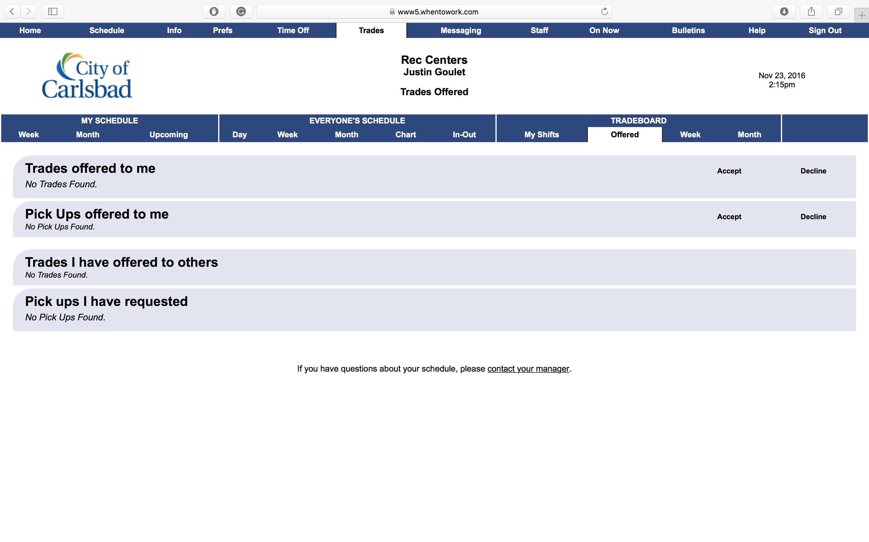
Tradeboard - Offered
Tip:
Here, you have a general overview of all shifts available for trade, trades you have offered others, and more.
When shifts become available, you can select the appropriate checkbox to confirm/deny a possible a trade.
Click any option in the highlighted area to view another page.

Slide 15
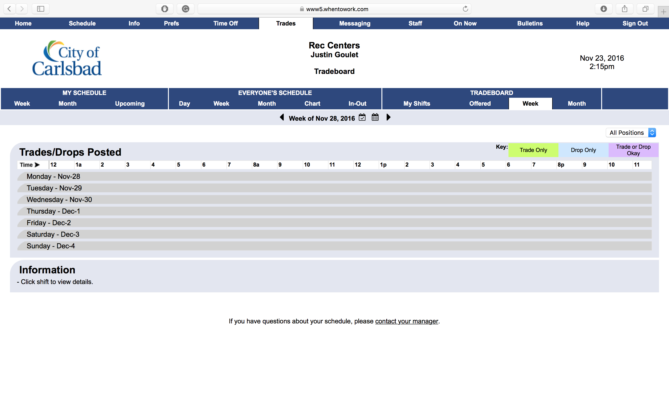
Tradeboard – Week
Tip:
In the Week tab, you can view all available shifts for the week, including those that are looking to trade, and/or give up their shift.
Note you may advance to different weeks by clicking the arrow to the right of the current date.
Click any option in the highlighted area to view another page.

Slide 16
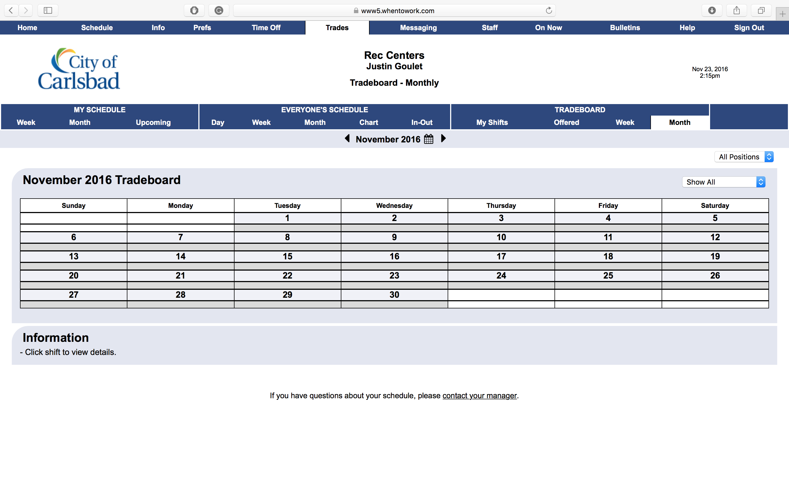
Tradeboard - Month
Tip:
Finally, the month view shows you similar information as the week view, but for the entire month. Just click a shift to view the details and to confirm/deny the trade.
Click Sign-Out to complete.

